Slide 1

Applied Text Analytics ( F20/F21AA ) Text Classification II Heriot Watt University , Dubai Campus
Dr. Neamat El Gayar

Slide 2
Topics of the lecture
Naïve Bayes (revisited) for Text Classification
Support Vector Machines (SVM)
Revisiting Classifier Evaluation

Slide 3
Main slide source NLP || Dan Jurafsky || Stanford University
Lectures slides and references
Chapter 4 Speech and Language Processing (3rd draft)
Notes:
s

Slide 4
Classification Methods: Supervised Machine Learning
Any kind of classifier
Naïve Bayes
Logistic regression
Support-vector machines
k-Nearest Neighbors
…

Slide 5
Text Classification and Naïve Bayes
Text Classification: Features and Model

Slide 6
The bag of words representation
Introduction to Information Retrieval
I love this movie! It's sweet, but with satirical humor. The dialogue is great and the adventure scenes are fun… It manages to be whimsical and romantic while laughing at the conventions of the fairy tale genre. I would recommend it to just about anyone. I've seen it several times, and I'm always happy to see it again whenever I have a friend who hasn't seen it yet.
γ(
)=c
Notes:
Only use set of words and count

Slide 7


The bag of words representation
I love this movie! It's sweet, but with satirical humor. The dialogue is great and the adventure scenes are fun… It manages to be whimsical and romantic while laughing at the conventions of the fairy tale genre. I would recommend it to just about anyone. I've seen it several times, and I'm always happy to see it again whenever I have a friend who hasn't seen it yet.
γ(
)=c

Slide 8
The bag of words representation: using a subset of words
x love xxxxxxxxxxxxxxxx sweet xxxxxxx satirical xxxxxxxxxx xxxxxxxxxxx great xxxxxxx xxxxxxxxxxxxxxxxxxx fun xxxx xxxxxxxxxxxxx whimsical xxxx romantic xxxx laughing xxxxxxxxxxxxxxxxxxxxxxxxxxxxxxxxxxxxxxxxxxxx recommend xxxxx xxxxxxxxxxxxxxxxxxxxxxxxxxxxxxxx several xxxxxxxxxxxxxxxxx xxxxx happy xxxxxxxxx again xxxxxxxxxxxxxxxxxxxxxxxxxxxxxxxxxxxxxxxxxxxxxxx
γ(
)=c

Slide 9
The bag of words representation
Introduction to Information Retrieval
great | 2
love | 2
recommend | 1
laugh | 1
happy | 1
... | ...
γ(
)=c

Slide 10
Naïve Bayesian Classifier
Determine the most probable class label for each document
Based on the observed document attributes (words)
Naïvely assumes words to be conditionally independent of each other
Class label probabilities are determined using Bayes’ Law
Input set of words
Output:
Probability score – proportional to the true probability
Class label – based on the highest probability score
Notes:
The Naïve Bayesian Classifier is a probabilistic classifier based on Bayes' Law and naïve conditional independence assumptions. In simple terms, a Naïve Bayes Classifier assumes that the presence (or absence) of a particular feature of a class is unrelated to the presence (or absence) of any other feature.
For example, an object can be classified into a particular category based on its attributes such as shape, color, and weight. A reasonable classification for an object, that is spherical, yellow and less than 60 grams in weight, may be a tennis ball. Even if these features depend on each other or upon the existence of the other features, a Naïve Bayesian Classifier considers all of these properties to independently contribute to the probability that the object is a tennis ball.
The input variables are generally discrete (categorical) but there are variations to the algorithms that work with continuous variables as well. For this lesson, we will consider only discrete input variables. Although weight may be considered a continuous variable, in the tennis ball example, weight was grouped into intervals in order to make weight a categorical variable.
The output typically returns a probability score and class membership. The output from most implementations are log probability scores for the class (we will address this later in the lesson) and we assign the class label that corresponds to the highest log probability score.

Slide 11
Naïve Bayesian Classifier - Use Cases
Preferred method for many text classification problems.
Try this first; if it doesn't work, try something more complicated
Use cases
Spam filtering, other text classification tasks
Fraud detection
Notes:
Naïve Bayesian Classifiers are among the most successful known algorithms for learning to classify text documents. Spam filtering is the best known use of Naïve Bayesian Text Classification. Bayesian Spam Filtering has become a popular mechanism to distinguish illegitimate spam email from legitimate email. Many modern mail clients implement Bayesian Spam Filtering.
Naïve Bayesian Classifiers are used to detect fraud. For example in auto insurance, based on a training data set with attributes (such as driver’s rating, vehicle age, vehicle price, is it a claim by the policy holder, police report status, claim genuine ) we can classify a new claim as genuine or not.
References:
Spam filtering (http://en.wikipedia.org/wiki/Bayesian_spam_filtering)
http://www.cisjournal.org/archive/vol2no4/vol2no4_1.pdf
Hybrid Recommender System Using Naive Bayes Classifier and Collaborative Filtering (http://eprints.ecs.soton.ac.uk/18483/
Online applications (http://www.convo.co.uk/x02/)

Slide 12
Bayes’ Rule
For a document d and a class c
prior
likelihood
posterior
P(+ve review|document) ?
Subjectivist view of probability:
Fraction of times the terms appearing in d (x1,x2,...) also appear in +ve review documents ; P(d|+ve reviews)
Fraction documents with +ve reviews in training set; P(+ve reviews)
Notes:
Exact data will not be available -→ caused the dismissal of probabilistic approach to uncertainty:
Need of objective empirical investigations (huge data)
Joint distribution function, assigns probability to every elementary event
One could work with estimate of occurrences --→

Slide 13
Naïve Bayes Classifier (I)
MAP is “maximum a posteriori” = most likely class
Bayes Rule
Dropping the denominator

Slide 14
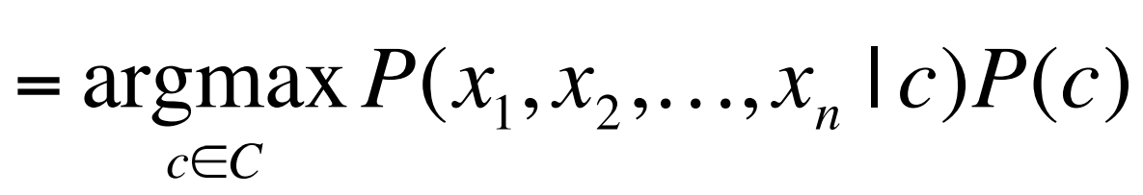
Naïve Bayes Classifier (II)
Document d represented as features x₁..x_{n}

Slide 15
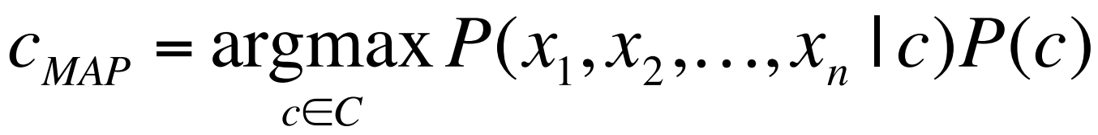
Naïve Bayes Classifier (III)
O(|X|^{n}•|C|) parameters
How often does this class occur?
Could only be estimated if a very, very large number of training examples was available.
We can just count the relative frequencies in a corpus

Slide 16
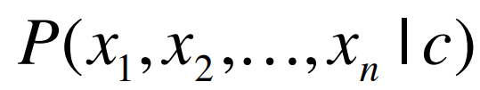
Multinomial Naïve Bayes Independence Assumptions
Bag of Words assumption: Assume position doesn’t matter
Conditional Independence: Assume the feature probabilities P(x_{i}|c_{j}) are independent given the class c.

Slide 17
Applying Multinomial Naive Bayes Classifiers to Text Classification
positions ← all word positions in test document

Slide 18
Problem with Maximum Likelihood
Sec.13.3
What if we have seen no training documents with the word fantastic and classified in the topic positive (thumbs-up)?
Zero probabilities cannot be conditioned away, no matter the other evidence!

Slide 19
Laplace (add-1) smoothing for Naïve Bayes

Slide 20
Multinomial Naïve Bayes: Learning
From training corpus, extract Vocabulary
Calculate P(c_{j}) terms
For each c_{j} in C do
docs_{j} ← all docs with class =c_{j}
Calculate P(w_{k} | c_{j}) terms
Text_{j} ← single doc containing all docs_{j}
For each word w_{k} in Vocabulary
n_{k} ← # of occurrences of w_{k} in Text_{j}
Notes:
n is count of all words in Textj

Slide 21
 | Doc | Words | Class
Training | 1 | Chinese Beijing Chinese | c
 | 2 | Chinese Chinese Shanghai | c
 | 3 | Chinese Macao | c
 | 4 | Tokyo Japan Chinese | j
Test | 5 | Chinese Chinese Chinese Tokyo Japan | ?
Priors:
P(c)=
P(j)=
Choosing a class:
P(c|d5)
P(j|d5)
Conditional Probabilities:
P(Chinese|c) =
P(Tokyo|c) =
P(Japan|c) =
P(Chinese|j) =
P(Tokyo|j) =
P(Japan|j) =

Slide 22
 | Doc | Words | Class
Training | 1 | Chinese Beijing Chinese | c
 | 2 | Chinese Chinese Shanghai | c
 | 3 | Chinese Macao | c
 | 4 | Tokyo Japan Chinese | j
Test | 5 | Chinese Chinese Chinese Tokyo Japan | ?
Priors:
P(c)=
P(j)=
3
4
1
Choosing a class:
P(c|d5)
P(j|d5)
4
3/4 * (3/7)³ * 1/14 * 1/14
≈ 0.0003
Conditional Probabilities:
P(Chinese|c) =
P(Tokyo|c) =
P(Japan|c) =
P(Chinese|j) =
P(Tokyo|j) =
P(Japan|j) =
(5+1) / (8+6) = 6/14 = 3/7
(0+1) / (8+6) = 1/14
1/4 * (2/9)³ * 2/9 * 2/9
≈ 0.0001
(0+1) / (8+6) = 1/14
(1+1) / (3+6) = 2/9
(1+1) / (3+6) = 2/9
(1+1) / (3+6) = 2/9

Slide 23
Underflow Prevention: log space
Multiplying lots of probabilities can result in floating-point underflow.
Since log(xy) = log(x) + log(y)
Better to sum logs of probabilities instead of multiplying probabilities.
Class with highest un-normalized log probability score is still most probable.
Model is now just max of sum of weights

Slide 24
Naïve Bayes and Language Modeling – next week
Naïve bayes classifiers can use any sort of feature
URL, email address, dictionaries, network features
But if, as in the previous slides
We use only word features
If we use all of the words in the text (not a subset) then
Naïve bayes has an important similarity to language modeling.

Slide 25
Summary of Naïve Bayes
Reports from literature findings (Introduction to Information Retrieval, Manning, Raghavan & Schutze)

Slide 26
Why does Naive Bayes work?
Naive Bayes can work well even though conditional independence assumptions are badly violated.
Classification is about predicting the correct class and not about accurately estimating probabilities
Correct estimation ⇒ accurate prediction.(But not vice versa!) NB classifiers estimate badly, but often classify well.
26

Slide 27
Why does Naive Bayes work?
Naive Bayes can work well even though conditional independence assumptions are badly violated.
Classification is about predicting the correct class and not about accurately estimating probabilities
Correct estimation ⇒ accurate prediction.(But not vice versa!) NB classifiers estimate badly, but often classify well.
27

Slide 28
Bias-Variance Tradeoff

Slide 29
kNN vs. Naive Bayes
Sec.14.6
Bias/Variance tradeoff:
Model needs to be neither too simple (in which case it will underfit) nor too complex (in which case it will overfit).
Diagnostic for bias and Variance: (Bias Variance trade-off)
Variance: Training error will be much lower than test error.
Bias: Training error will also be high.
kNN has high variance and low bias.
Infinite memory
NB has low variance and high bias.
Linear decision surface (hyperplane – see later)
Notes:
Bias/variance in terms of resulting classifier given randomly selected training set; why it is a tradeoff; when to choose low-bias method, when to choose low-variance method
The bias is an error from erroneous assumptions in the learning algorithm. High bias can cause an algorithm to miss the relevant relations between features and target outputs. In other words, model with high bias pays very little attention to the training data and oversimplifies the model.(underfitting)
The variance is an error from sensitivity to small fluctuations in the training set. High variance can cause an algorithm to model the random noise in the training data, rather than the intended outputs. In other words, model with high variance pays a lot of attention to training data and does not generalize on the data which it hasn’t seen before. (overfitting)
Underfitting means the model does not fit, in other words, does not predict, the (training) data very well. On the other hand, overfitting means that the model predict the (training) data too well. Which could not generalize well to unseen data. Normally, underfitting implies high bias and low variance, and overfitting implies low bias but high variance.
https://medium.com/30-days-of-machine-learning/day-3-k-nearest-neighbors-and-bias-variance-tradeoff-75f84d515bdb
Variance ≈ Capacity

Slide 30
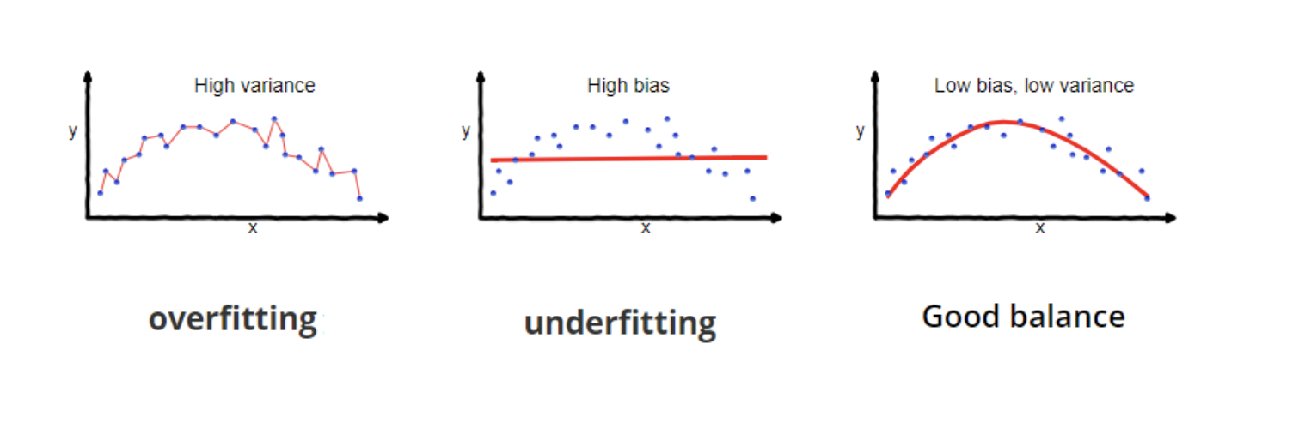
Bias vs. variance: Choosing the correct model capacity
Sec.14.6
Notes:
https://towardsdatascience.com/understanding-the-bias-variance-tradeoff-165e6942b229

Slide 31
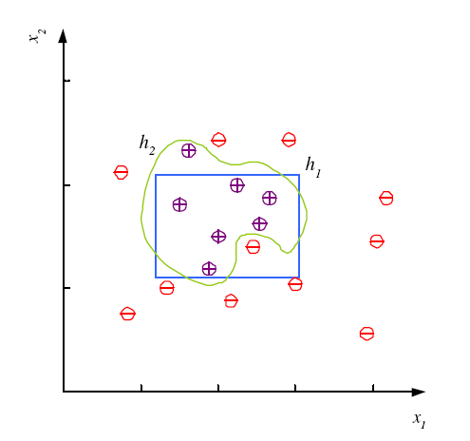
Noise and Model Complexity
Use the simpler one because
Simpler to use
(lower computational complexity)
Easier to train
(lower space complexity)
Easier to explain
(more interpretable)
Generalizes better
(lower variance - Occam’s razor)
Notes:
Noise: measurement- fault in labelling- missing features

Slide 32
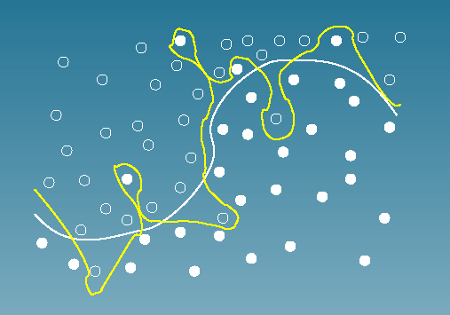
Bias vs. variance: Choosing the correct model capacity
Sec.14.6
Simple model?

Slide 33
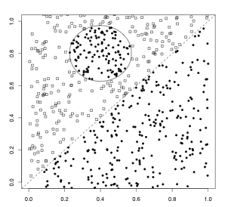
Bias vs. variance: Choosing the correct model capacity
A nonlinear problem
Complex model?
Linear classifier like Rocchio does badly on this task.
kNN will do well (assuming enough training data)
33

Slide 34
Which classifier do I use for a given text classification problem?
Is there a learning method that is optimal for all text classification problems?
No, because there is a tradeoff between bias and variance.
Factors to take into account:
How much training data is available?
How simple/complex is the problem? (linear vs. nonlinear decision boundary)
How noisy is the data?
How stable is the problem over time?
For an unstable problem, its better to use a simple and robust classifier.

Slide 35
Support Vector Machines
Notes:
(Don’t worry about the math ….just get the general idea behind SVM)
https://nlp.stanford.edu/IR-book/pdf/15svm.pdf

Slide 36
Why are SVM interesting?
Discriminant based Classifiers
Linear Classifier that use the ‘Kernel trick’ for nonlinearity
Maximize generalization
Support vectors represent knowledge
Learning is based on complex optimization
Notes:
Classification method for both linear and nonlinear data
It uses a nonlinear mapping to transform the original training data into a higher dimension
With the new dimension, it searches for the linear optimal separating hyperplane (i.e., “decision boundary”)
With an appropriate nonlinear mapping to a sufficiently high dimension, data from two classes can always be separated by a hyperplane
SVM finds this hyperplane using support vectors (“essential” training tuples) and margins (defined by the support vectors)
Features: training can be slow but accuracy is high owing to their ability to model complex nonlinear decision boundaries (margin maximization)
Used for: classification and numeric prediction

Slide 37
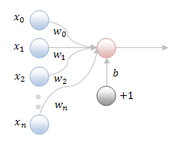
Review of Linear Classifiers
Linear classifiers
One of the simplest classifiers
Linear decision boundary
Applicable to linearly separable tasks
Perceptron
One of the most popular linear classifiers
Perceptron learning
Given a training set containing a number of examples with labels
Iteratively update weights of linear equation until convergence
Sensitive to initialisation and example input orders during learning
Could generate decision boundaries of different generalization capabilities
x2
+1
-1
x1

Slide 38
Motivation and Concept
Perceptron learning
denotes +1
denotes -1
Q: How would you classify this data set with the perceptron?

Slide 39
Motivation and Concept
Perceptron learning
denotes +1
denotes -1
Q: How would you classify this data set?
A: using perceptron learning rule to learn weights w, b

Slide 40
Motivation and Concept
Perceptron learning
denotes +1
denotes -1
Q: How would you classify this data set?
A: Using perceptron learning rule to learn weights w, b
Q: With different initial values of w, b and example orders what happens?

Slide 41
Motivation and Concept
Perceptron learning
Q: How would you classify this data set?
A: Using perceptron learning rule to learn weights w, b
Q: With different initial values of w, b and example orders what happens?
A: Leading to many decision boundaries
denotes +1
denotes -1

Slide 42
Motivation and Concept
Perceptron learning
Q: How would you classify this data set?
A: Using perceptron learning rule to learn weights w, b
Q: With different initial values of w, b and example orders what happens?
A: Leading to many decision boundaries
Q: Which decision boundary is the best for generalisation?
denotes +1
denotes -1

Slide 43
Motivation and Concept
Margin of linear classifier
denotes +1
denotes -1
Definition:
The margin of a linear classifier as the width that the boundary could be increased by before hitting a data point.

Slide 44
Motivation and Concept
Maximum margin
denotes +1
denotes -1
The maximum margin is
the one with the widest
width to a data point.
The maximum margin
linear classifier is linear
Support Vector Machines.
Notes:
The best hyperplane should be the one that separate classes with the widest margin

Slide 45
Motivation and Concept
Support Vectors
denotes +1
denotes -1
Support Vectors are
those data points
that the margin
pushes up against
Support Vectors

Slide 46
Motivation and Concept
SVM: the best solution in terms of generalisation
Intuitively this feels safest.
If we’ve made a small error in the location of the boundary this gives us least chance of causing a misclassification.
The model is immune to removal of any non-support-vector data points.
There’s some theory (using VC dimension) that is related to the proposition that this is a good thing.
Empirically it works very well.
denotes +1
denotes -1
Support Vectors

Slide 47
Calculating the margin (SVM)
Sec. 15.1
Hyperplane
w^{T} x + b = 0
This implies:
w^{T}(x_{a}–x_{b}) = 2
ρ = x_{a}–x_{b} = 2/||w|| (margin)
ρ
w^{T}x_{a} + b = 1
w^{T}x_{b} + b = -1
w^{T} x + b = 0
Notes:
xa and xb are vectors ( 2-dim) on the hyperplanes
The goal is to maximize the margin

Slide 48
SVM Learning
Objectives: finding appropriate weights w and bias b to
minimize training errors (the same as that of Perceptron)
maximize the margin
What is the relationship between weights and margin?
with knowledge of analytic geometry, we obtain
Support vectors:
Learning rule is no longer that simple like perceptron!
need to search the space of w’s and b’s to find the widest margin that matches all the data points or support vectors
How? Using a Quadratic Programming (QP) algorithm!
Notes:
Y are the labels (-1 or +1)

Slide 49
Optimization problem!
Definition (Linear SVM: separable case): Given a set of linearly separable training examples,
D = {(x₁, y₁), (x₂, y₂), …, (x_{r}, y_{r})}
Learning is to solve the following constrained minimization problem,
The constraint
summarizes to:
⟨w ⋅ x_{i}⟩ + b ≥ 1 for y_{i} = 1
⟨w ⋅ x_{i}⟩ + b ≤ -1 for y_{i} = -1
Notes:
Y are the labels (-1 or +1)

Slide 50
Solving the Optimization Problem
Sec. 15.1
This is now optimizing a quadratic function subject to linear constraints
Quadratic optimization problems are a well-known class of mathematical programming problem, and many (intricate) algorithms exist for solving them (with many special ones built for SVMs)
The solution involves constructing a dual problem where a Lagrange multiplier α_{i} is associated with every constraint in the primary problem:
Find w and b such that
Φ(w) =½ w^{T}w is minimized;
and for all {(x_{i} ,y_{i})}: y_{i} (w^{T}x_{i} + b) ≥ 1
Find α₁…α_{N} such that
Q(α) =Σα_{i} - ½ΣΣα_{i}α_{j}y_{i}y_{j}x_{i}^{T}x_{j} is maximized and
(1) Σα_{i}y_{i} = 0
(2) α_{i} ≥ 0 for all α_{i}
Notes:
Y are the labels (-1 or +1)

Slide 51
The final decision boundary (Solution of Optimization)
Finding the support vectors is equivalent to training the SVM
From optimization we obtain the values for α_{i}, which are used to compute the weight vector w and the bias b
The decision boundary
Testing: Use (1). Given a test instance z,
If (2) returns 1, then the test instance z is classified as positive; otherwise, it is classified as negative, x_{i} are the support vectors.
(1)
(2)

Slide 52
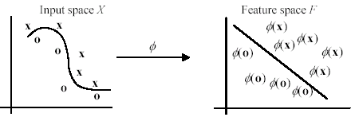
How to deal with nonlinear separation?
To deal with nonlinear separation, the same formulation and techniques as for the linear case are still used.
We only transform the input data into another space (usually of a much higher dimension) so that
a linear decision boundary can separate positive and negative examples in the transformed space,

Slide 53
Space transformation
The basic idea is to map the data in the input space X to a feature space F via a nonlinear mapping φ,
After the mapping, the original training data set {(x₁, y₁), (x₂, y₂), …, (x_{r}, y_{r})} becomes:
{(φ(x₁), y₁), (φ(x₂), y₂), …, (φ(x_{r}), y_{r})}

Slide 54
Kernel trick
In solving the quadratic optimization problem of SVM we only require dot products ⟨φ(x) ⋅ φ(z)⟩ and never the mapped vector φ(x) in its explicit form. This is a crucial point.
Good news: explicit transformation is not needed.
We can simply apply the kernel function directly by
replace all the dot products ⟨φ(x) ⋅ φ(z)⟩ in the optimization problem with the kernel function K(x, z) (e.g., the polynomial kernel ⟨x ⋅ z⟩^{d} )
kernel functions, denoted by K, K(x, z) = ⟨φ(x) ⋅ φ(z)⟩
(82)
Notes:
Thus, if we have a way to compute the dot product ⟨φ(x) ⋅ φ(z)⟩ using the input vectors x and z directly,
no need to know the feature vector φ(x) or even φ itself.
This strategy is called the kernel trick.

Slide 55
Kernel example

Slide 56
An example kernel function
Polynomial kernel
K(x, z) = ⟨x ⋅ z⟩^{d}
Let us compute the kernel with degree d = 2 in a 2-dimensional space: x = (x₁, x₂) and z = (z₁, z₂).
This shows that the kernel ⟨x ⋅ z⟩² is a dot product in a transformed feature space

Slide 57
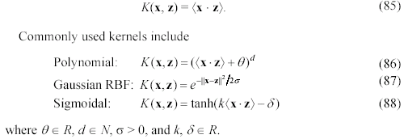
Commonly used kernels
It is clear that the idea of kernel generalizes the dot product in the input space. This dot product is also a kernel with the feature map being the identity

Slide 58
Some other issues in SVM
SVM works only in a real-valued space. Need to convert its categorical values to numeric values.
For multi-class problems, some strategies can be applied, e.g., one-against-rest, and error-correcting output coding.
The hyperplane produced by SVM is hard to understand by human users. The matter is made worse by kernels. Thus, SVM is commonly used in applications that do not required human understanding.

Slide 59
SVM for text classification
Choose hyperplane based on support vectors
Support vector = “critical” point close to decision boundary
One of the best performing text classifier
Other methods that perform about as well as SVM, such as regularized logistic regression
Partly popular due to availability of good software
SVMlight is accurate and fast – and free (for research)
Now lots of good software: libsvm, TinySVM, ….
Scikit-learn also has its SVM implementations (SVC, SVR)

Slide 60
SVM summarized
(Linear) SVM is a state-of-the-art linear classifier
Developed based on statistical learning theory
Learning process seeking support vectors or maximum margin
Best generalisation performance guaranteed for linearly separable data sets
Kernel “trick”: extending linear SVM to non-linear SVM
In principle, data points are mapped onto a higher dimensional feature space so that they are linearly separable in that space
In reality, a kernel function directly works on the inner product of data points
With the kernel transformation, linear SVM extended to non-linear
SVM can be extended to multi-category classification
Notes:
Decompose the problem into multiple binary classification tasks
Variants of SVM that can tackle multi-category classification in a straightforward way

Slide 61
Classifier Evaluation
Precision, Recall, and the F measure
Book Reference sec 4.7 (Third Edition draft , Daniel Jurafsky & James H. Martin)

Slide 62
Evaluation
Let's consider just binary text classification tasks
Imagine you're the CEO of Delicious Pie Company
You want to know what people are saying about your pies
So you build a "Delicious Pie" tweet detector
Positive class: tweets about Delicious Pie Co
Negative class: all other tweets

Slide 63
The 2-by-2 confusion matrix

Slide 64
Evaluation: Accuracy
Why don't we use accuracy as our metric?
Imagine we saw 1 million tweets
100 of them talked about Delicious Pie Co.
999,900 talked about something else
We could build a dumb classifier that just labels every tweet "not about pie"
It would get 99.99% accuracy!!! Wow!!!!
But useless! Doesn't return the comments we are looking for!
That's why we use precision and recall instead

Slide 65
Evaluation: Precision
% of items the system detected (i.e., items the system labeled as positive) that are in fact positive (according to the human gold labels)

Slide 66
Evaluation: Recall
% of items actually present in the input that were correctly identified by the system.

Slide 67
Why Precision and recall
Our dumb pie-classifier
Just label nothing as "about pie"
Accuracy=99.99%
but
Recall = 0
(it doesn't get any of the 100 Pie tweets)
Precision and recall, unlike accuracy, emphasize true positives:
finding the things that we are supposed to be looking for.

Slide 68
A combined measure: F
A combined measure that assesses the P/R tradeoff is F measure (weighted harmonic mean):
The harmonic mean is a very conservative average; see IIR § 8.3
People usually use balanced F1 measure
i.e., with β = 1 (that is, α = ½): so, F1-score = 2PR/(P+R)
Notes:
a combined measure: F-measure: weighted harmonic mean between precision and recall
[why weighted? in some applications you may care more about P or R]
[why harmonic? it's conservative -- lower than arith or geo mean]
[if P and R are far apart, F tends to be near lower value]
[in order to do well on F1, need to do well on BOTH P and R]
[this way, can't beat the system by being either too reluctant or too promiscuous]
Comment: when ppl say f-measure w/o specifying beta, they mean balanced, and this is by far the most common way of doing it

Slide 69
More than two classes?

Slide 70
Confusion Matrix for 3-class classification

Slide 71
How to combine P/R from 3 classes to get one metric
Macroaveraging:
compute the performance for each class, and then average over classes
Microaveraging:
collect decisions for all classes into one confusion matrix
compute precision and recall from that table.

Slide 72
Macroaveraging and Microaveraging

Slide 73
Classifier Tuning and Testing

Slide 74
Development Test Sets ("Devsets") and Cross-validation
Train on training set, tune on devset, report on testset
This avoids overfitting (‘tuning to the test set’)
More conservative estimate of performance
But paradox: want as much data as possible for training, and as much for dev; how to split?
Training set
Development Test Set
Test Set

Slide 75
Cross-validation: multiple splits
Pool results over splits, Compute pooled dev performance

Slide 76
References for todays lecture
Introduction to Information Retrieval, Manning, Raghavan & Schutze.
Charu C. Aggarwal. “Machine Learning for Text.” Apple Books
An Introduction to Natural Language Processing, Computational Linguistics, and Speech Recognition, Third Edition draft , Daniel Jurafsky & James H. Martin (Chapter 2 & 3 &4 ).

Slide 77
Take home
For each of the classifiers discussed, research their hyper-parameters
You will need basic knowledge to investigate hyper-parameter tuning in python (hint: look up python documentation) – CW1
Prepare before week 4:
Lecture material and video ( N-grams- Language Models)
Lab week 4 (Experiment with N-grams Movie review example)
Recommended preparation: Scikit-Learn for text processing and classification (self-study overview lectures I & II)

Slide 78
Coming up Next
Week 4:
Discussion on Language models and N-grams ( advance preparation required)
Topic Modelling
Topic Modelling on Movie Review data set
Week 5 Text Analytics pipeline +Case Study
(Text Analytics A-Z workflow – SMS spam detection)
You will practice:
Fitting (training) and scoring of classifiers – using cross validation
Hyper parameter tuning
Some basic preprocessing
Basic pipelines in python
N-gram features

Slide 79
Thank You

